Slide 1
Some theories about overflow metabolism

Slide 2
Overflow metabolism is a ubiquitous consequence of fast-growing bacteria
Overflow: when cells are pushed to high metabolic rates, they exhibit incomplete catabolism of nutrients, with a lower energy yield and excretion of metabolic byproducts that could otherwise be used for catabolism or anabolism.
Examples:
Acetate switch in Escherichia coli
E. coli produces acetate at high growth rate in aerobic condition
Crabtree effect in Saccharomyces cerevisiae
S. cerevisiae produces ethanol in aerobic condition, with high external glucose
Warburg effect in cancer cells
Increased glucose uptake and fermentation of glucose to lactate

Slide 3
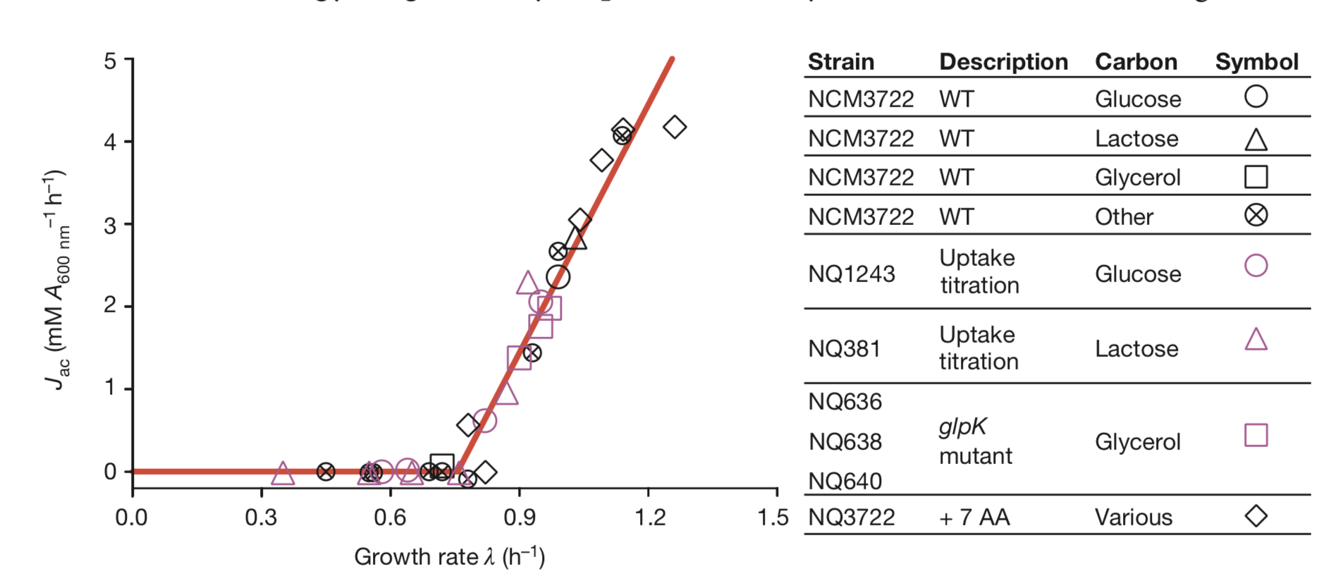

Acetate switch in E. coli
Slow growth: Energy limiting
Fast growth: Proteome limiting
Compared to respiration, acetate fermentation is energy inefficient but proteome efficient

Slide 4
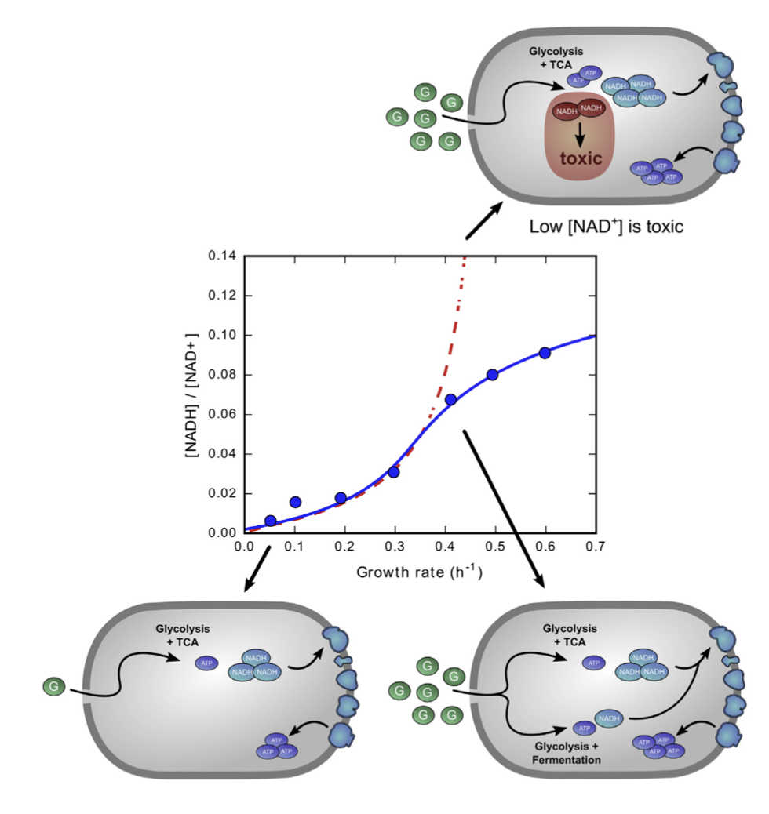
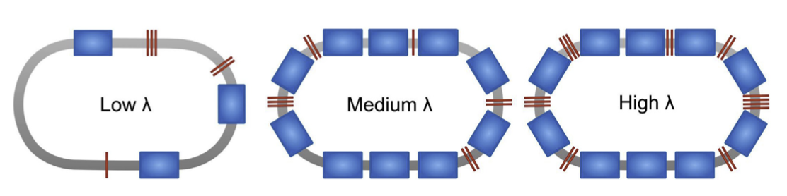
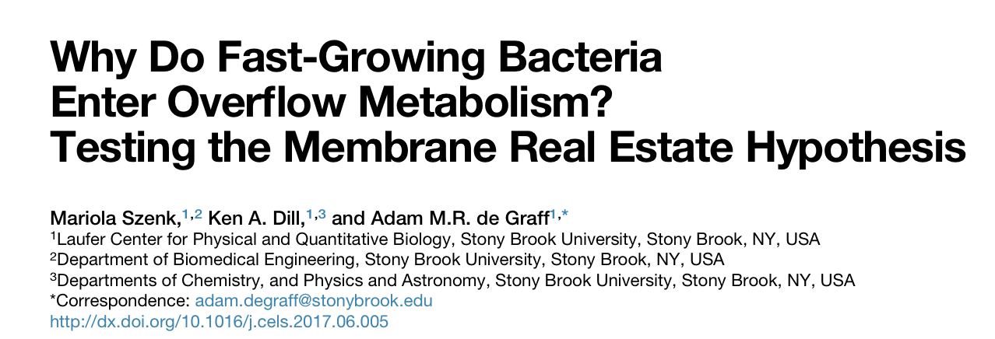
An alternative theory of acetate switch in E. coli
Fast growth drives cells to be bigger, reducing the membrane area available for respiratory proteins.
NADH/NAD ratio is the signal for overflow

Slide 5
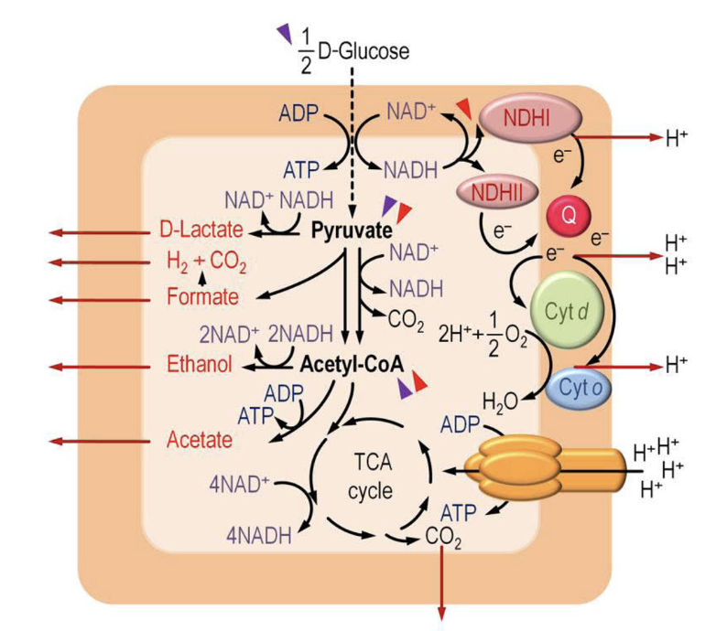
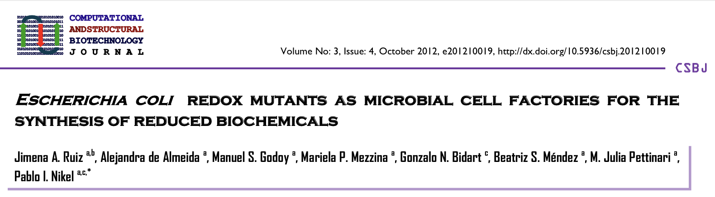
Fermentation pathways to deal with excess NADH produced by respiration

Slide 6
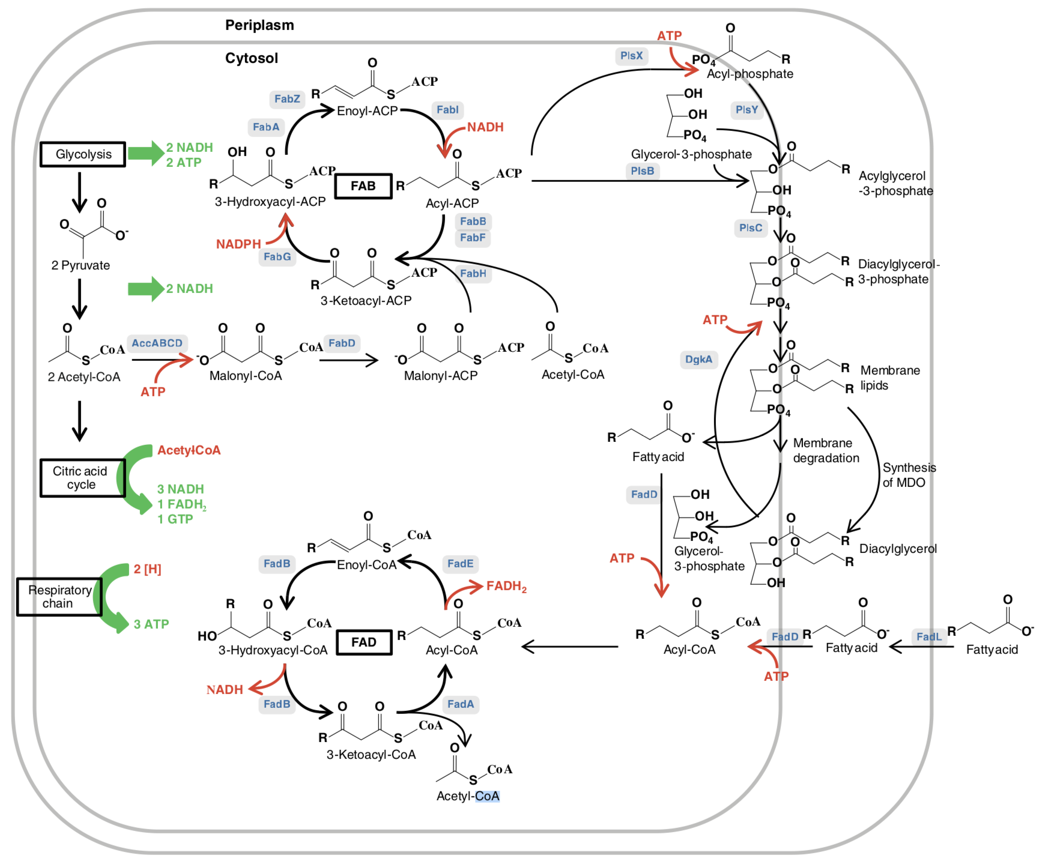
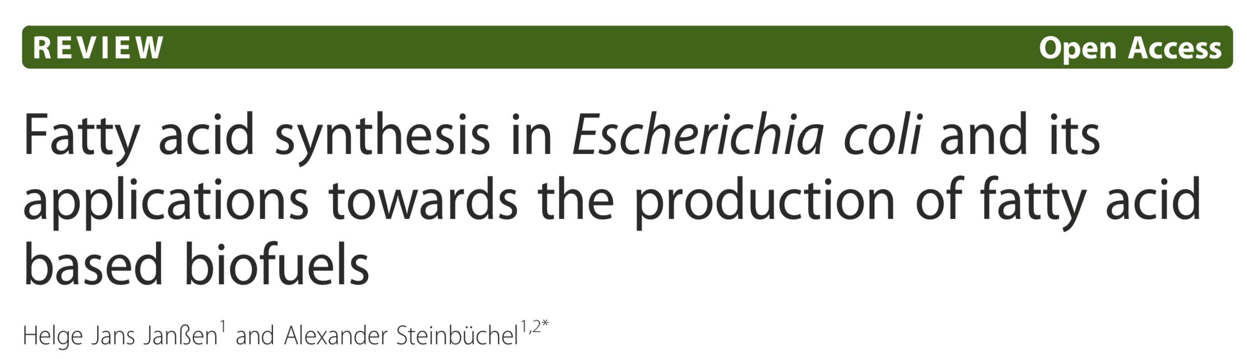
My hypothesis: rhamnolipid biosynthesis pathway dumps excess NADH and NADPH at the same time

Slide 7
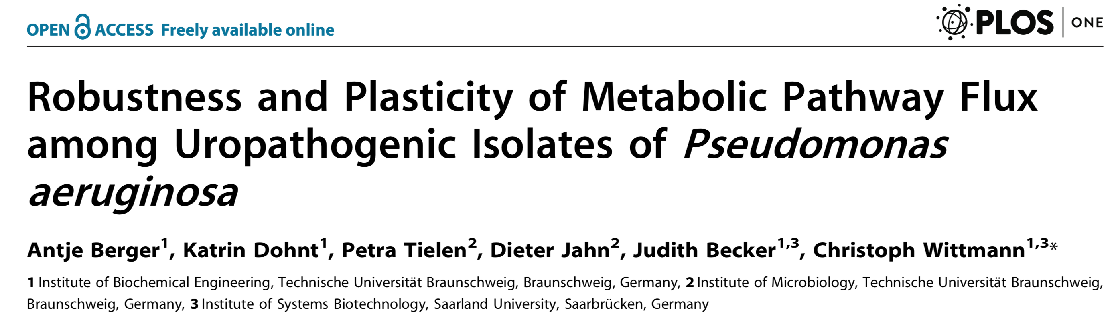
Why dumping NADPH?
Pseudomonas aeruginosa is a human pathogen that frequently causes urinary tract and catheter-associated urinary tract infections. Here, using 13C-metabolic flux analysis, we conducted quantitative analysis of metabolic fluxes in the model strain P. aeruginosa PAO1 and 17 clinical isolates. All P. aeruginosa strains catabolized glucose through the Entner-Doudoroff pathway with fully respiratory metabolism and no overflow. Together with other NADPH supplying reactions, this high-flux pathway (ED) provided by far more NADPH than needed for anabolism: a benefit for the pathogen to counteract oxidative stress imposed by the host. P. aeruginosa recruited the pentose phosphate pathway exclusively for biosynthesis. In contrast to glycolytic metabolism, which was conserved among all isolates, the flux through pyruvate metabolism, the tricarboxylic acid cycle, and the glyoxylate shunt was highly variable, likely caused by adaptive processes in individual strains during infection. This aspect of metabolism was niche-specific with respect to the corresponding flux because strains isolated from the urinary tract clustered separately from those originating from catheter-associated infections. Interestingly, most glucose- grown strains exhibited significant flux through the glyoxylate shunt. Projection into the theoretical flux space, which was computed using elementary flux-mode analysis, indicated that P. aeruginosa metabolism is optimized for efficient growth and exhibits significant potential for increasing NADPH supply to drive oxidative stress response.

Slide 8
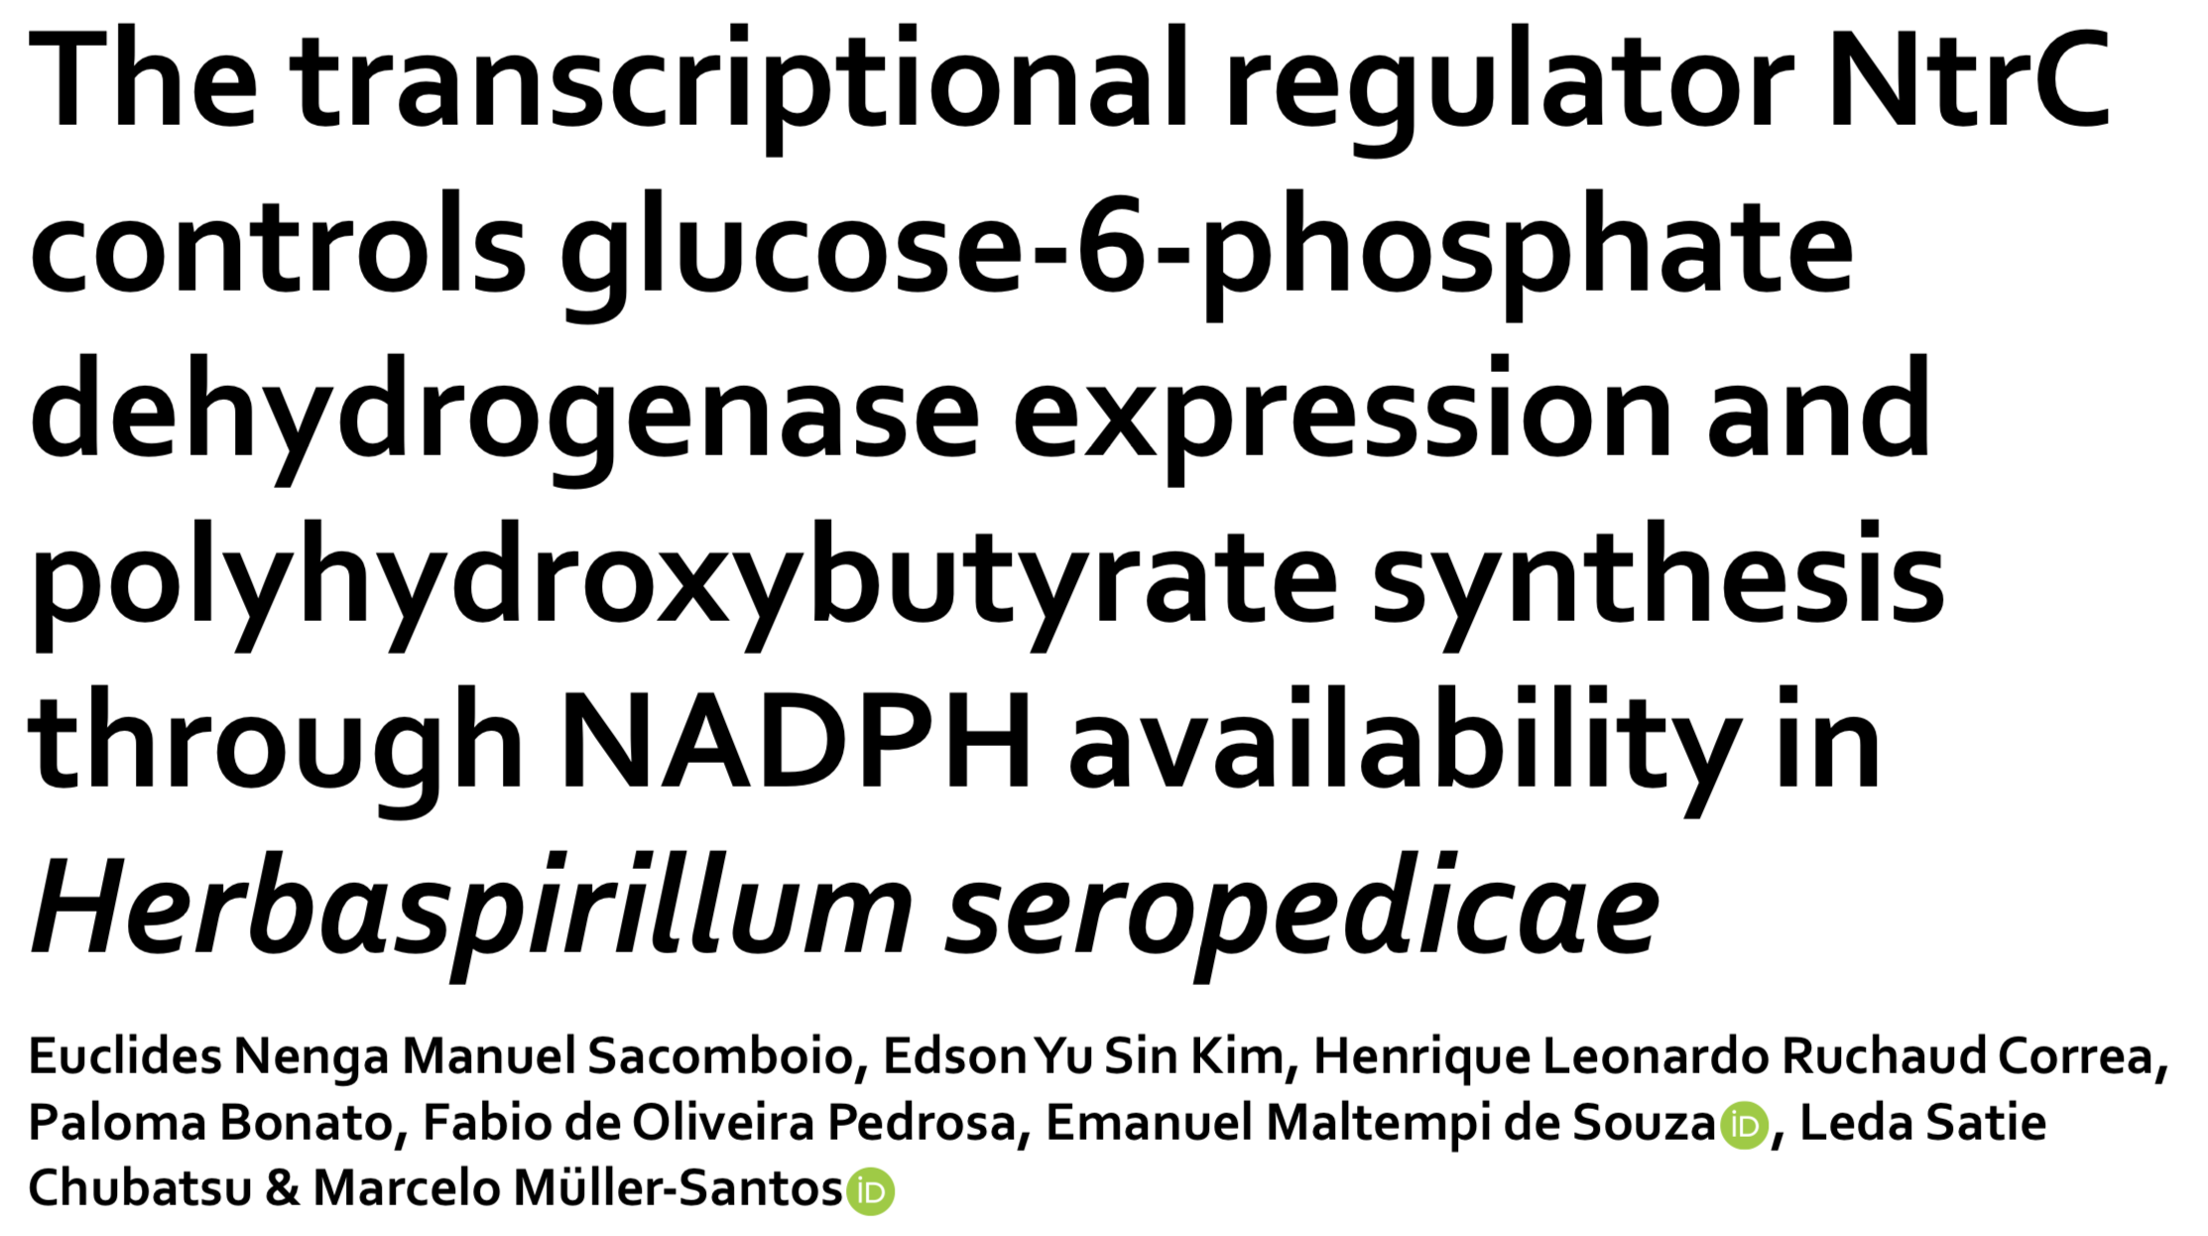
NADPH may be a signal for rhamnolipid production
The NTR system is the major regulator of nitrogen metabolism in Bacteria. Despite its broad and well- known role in the assimilation, biosynthesis and recycling of nitrogenous molecules, little is known about its role in carbon metabolism. In this work, we present a new facet of the NTR system in the control of NADPH concentration and the biosynthesis of molecules dependent on reduced coenzyme in Herbaspirillum seropedicae SmR1. We demonstrated that a ntrC mutant strain accumulated high levels of polyhydroxybutyrate (PHB), reaching levels up to 2-fold higher than the parental strain. In the absence of NtrC, the activity of glucose-6-phosphate dehydrogenase (encoded by zwf) increased by 2.8-fold, consequently leading to a 2.1-fold increase in the NADPH/NADP+ ratio. A GFP fusion showed that expression of zwf is likewise controlled by NtrC. The increase in NADPH availability stimulated the production of polyhydroxybutyrate regardless the C/N ratio in the medium. The mutant ntrC was more resistant to H2O2 exposure and controlled the propagation of ROS when facing the oxidative condition, a phenotype associated with the increase in PHB content.

Slide 9
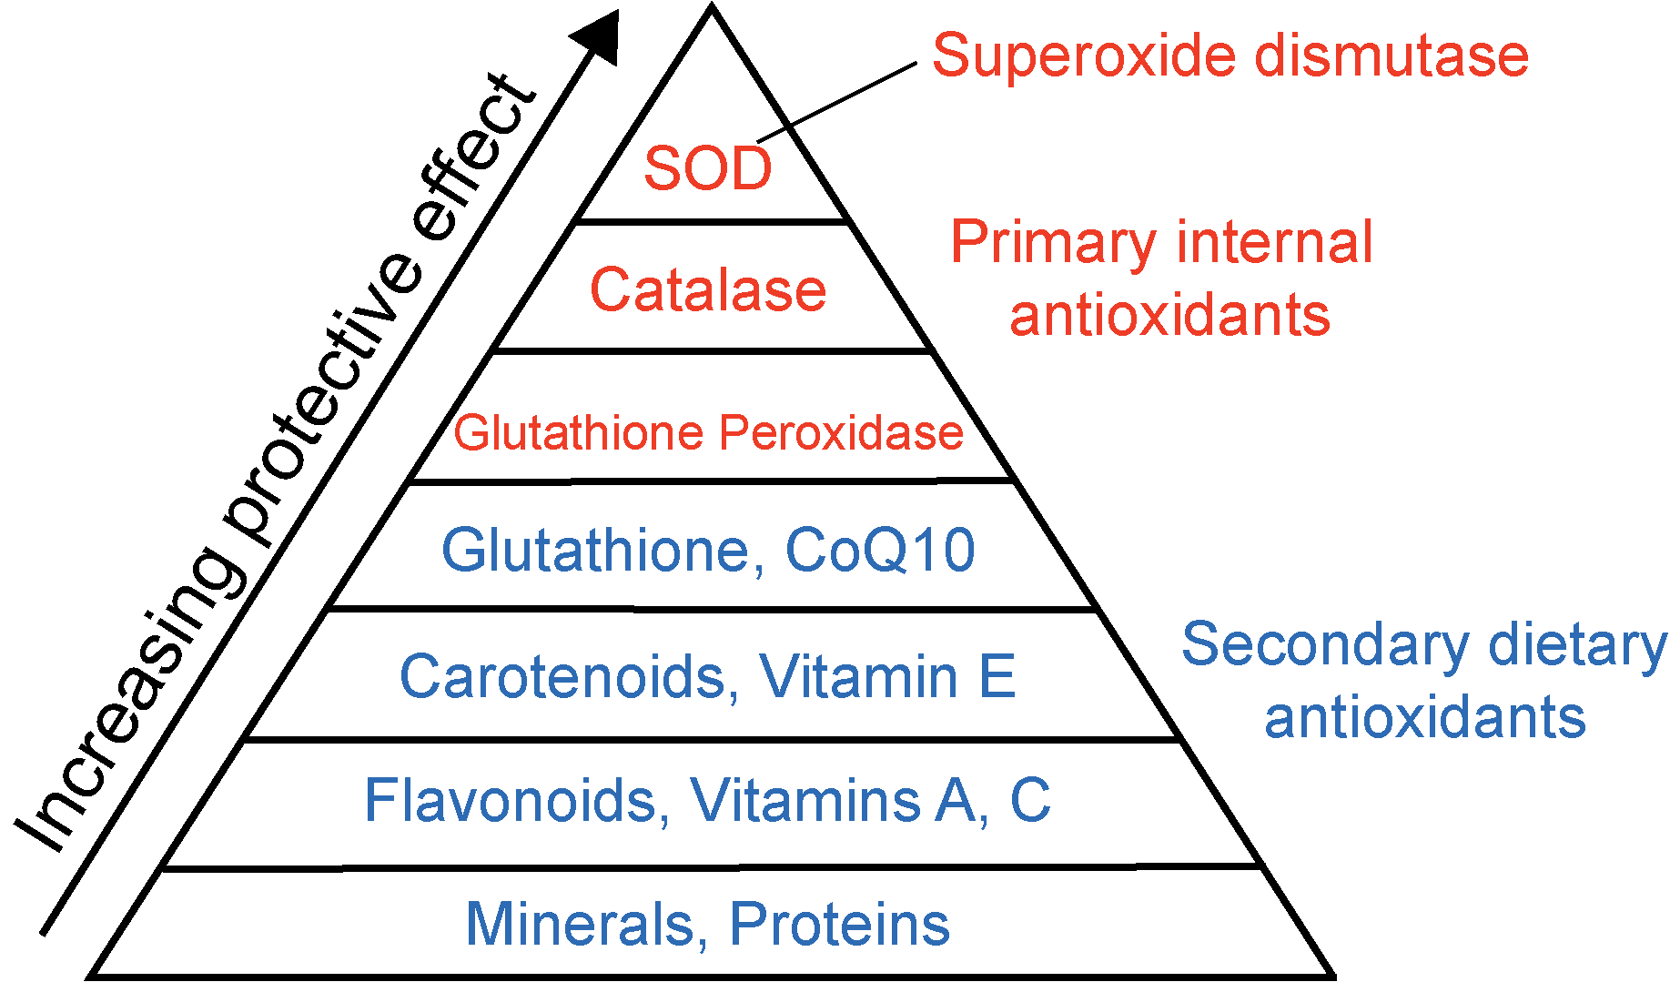
NADPH is important for oxidative stress response

Slide 10
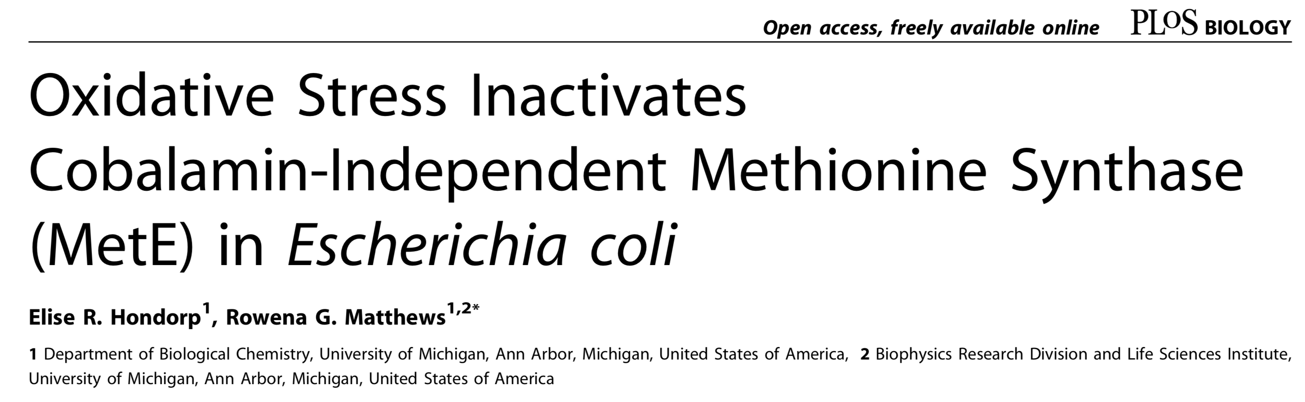
Links between oxidative stress, methionine availability, and MetE
In nature, Escherichia coli are exposed to harsh and non-ideal growth environments—nutrients may be limiting, and cells are often challenged by oxidative stress. For E. coli cells confronting these realities, there appears to be a link between oxidative stress, methionine availability, and the enzyme that catalyzes the final step of methionine biosynthesis, cobalamin-independent methionine synthase (MetE). We found that E. coli cells subjected to transient oxidative stress during growth in minimal medium develop a methionine auxotrophy, which can be traced to an effect on MetE. Further experiments demonstrated that the purified enzyme is inactivated by oxidized glutathione (GSSG) at a rate that correlates with protein oxidation. The unique site of oxidation was identified by selectively cleaving N- terminally to each reduced cysteine and analyzing the results by liquid chromatography mass spectrometry. Stoichiometric glutathionylation of MetE by GSSG occurs at cysteine 645, which is strategically located at the entrance to the active site. Direct evidence of MetE oxidation in vivo was obtained from thiol-trapping experiments in two different E. coli strains that contain highly oxidizing cytoplasmic environments. Moreover, MetE is completely oxidized in wild-type E. coli treated with the thiol-oxidizing agent diamide; reduced enzyme reappears just prior to the cells resuming normal growth. We argue that for E. coli experiencing oxidizing conditions in minimal medium, MetE is readily inactivated, resulting in cellular methionine limitation. Glutathionylation of the protein provides a strategy to modulate in vivo activity of the enzyme while protecting the active site from further damage, in an easily reversible manner. While glutathionylation of proteins is a fairly common mode of redox regulation in eukaryotes, very few proteins in E. coli are known to be modified in this manner. Our results are complementary to the independent findings of Leichert and Jakob presented in the accompanying paper (Leichert and Jakob 2004), which provide evidence that MetE is one of the proteins in E. coli most susceptible to oxidation. In eukaryotes, glutathionylation of key proteins involved in protein synthesis leads to inhibition of translation. Our studies suggest a simpler mechanism is employed by E. coli to achieve the same effect.

Slide 11
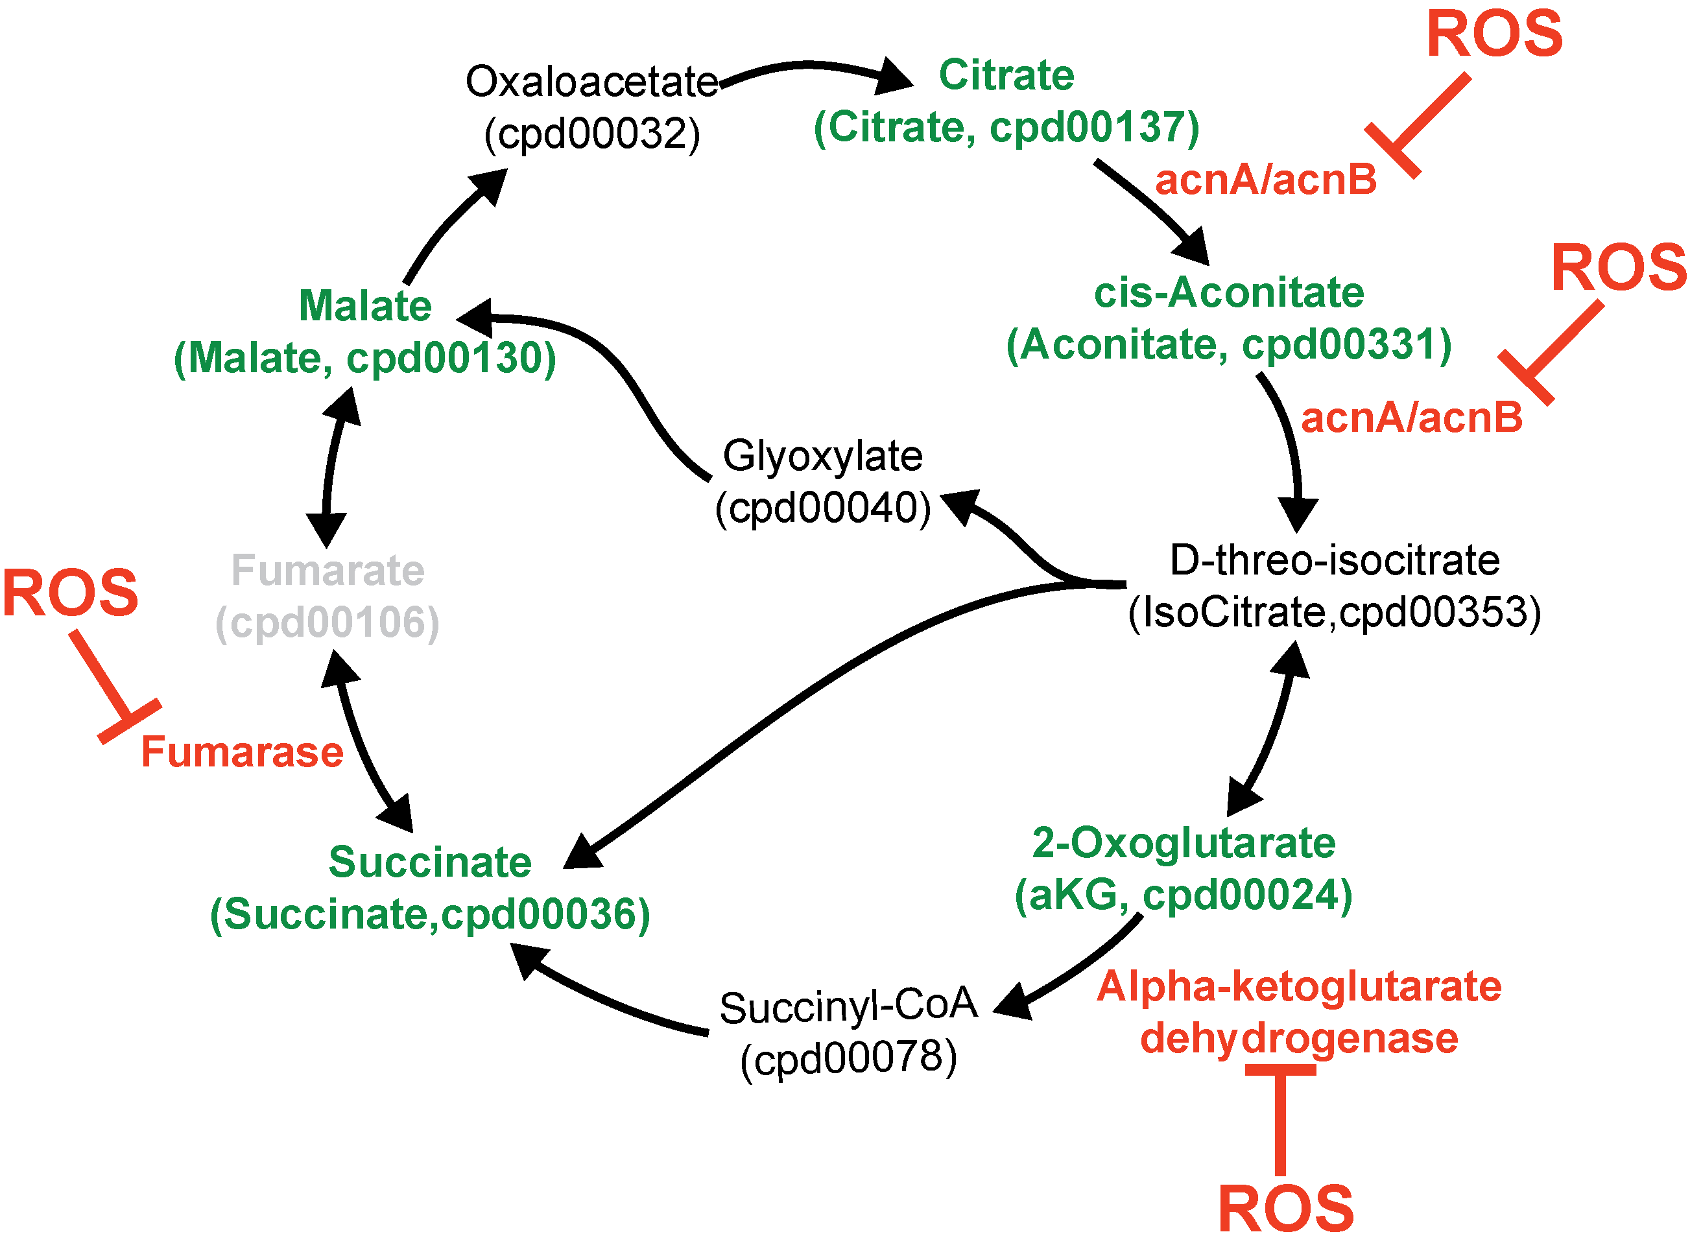
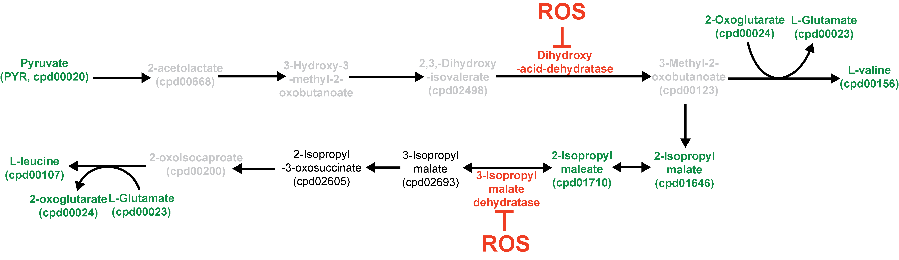
Evidences of oxidative stress from new metabolomics data
ROS (reactive oxygen species) inhibits aconitase-family enzymes (Fe-S cluster)

Slide 12
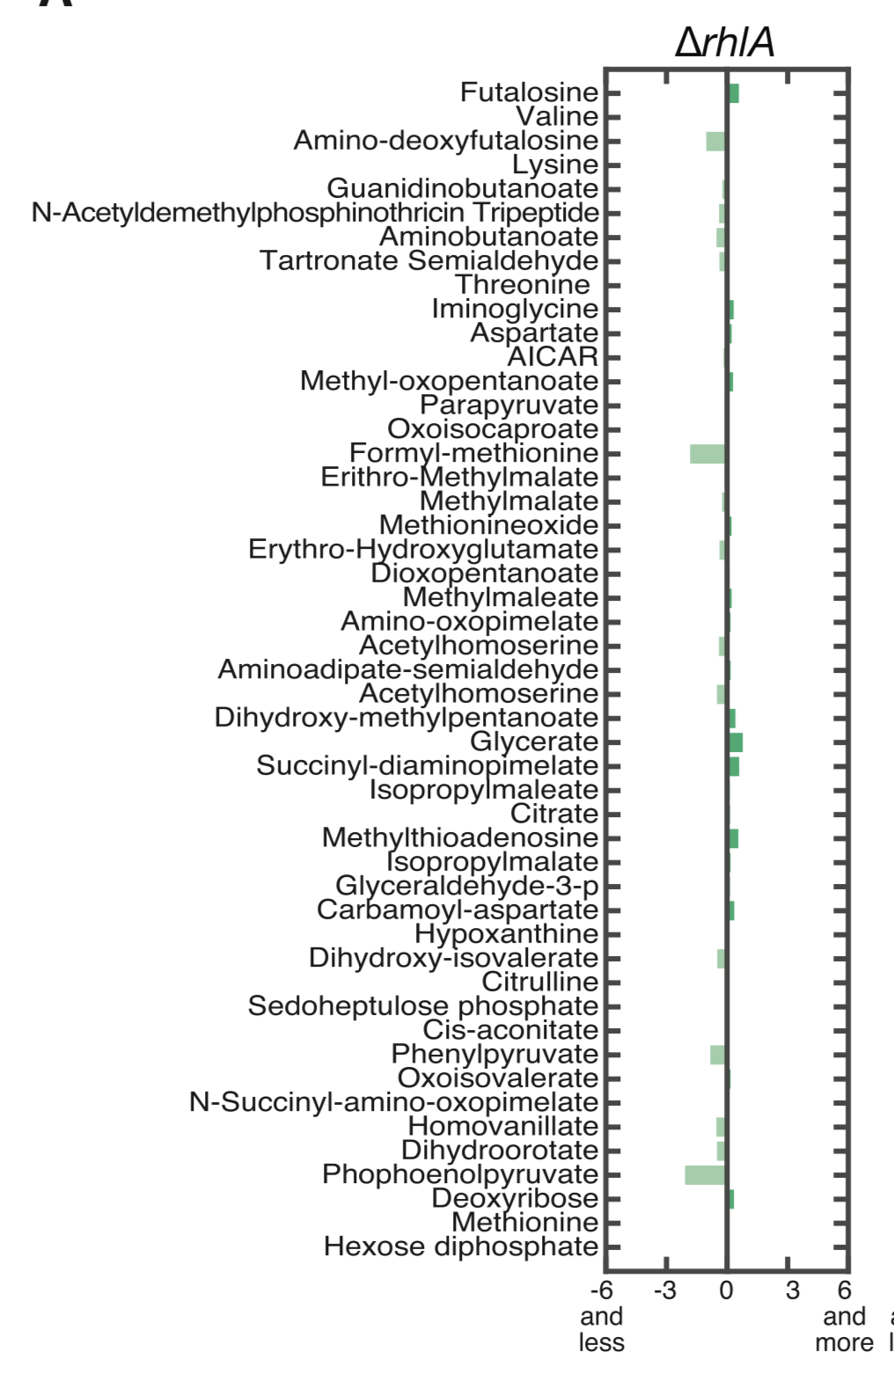
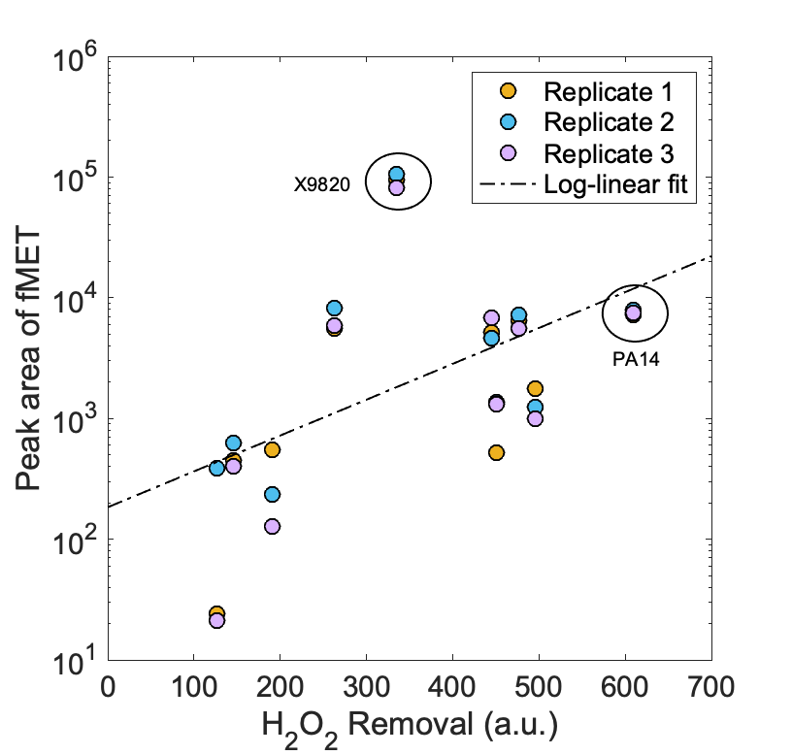
fMET is related to both oxidative stress and rhamnolipid production
fMET is tied to rhamnolipid production but not tied to growth.

Slide 13
Faster growers produce rhamnolipids

Slide 14
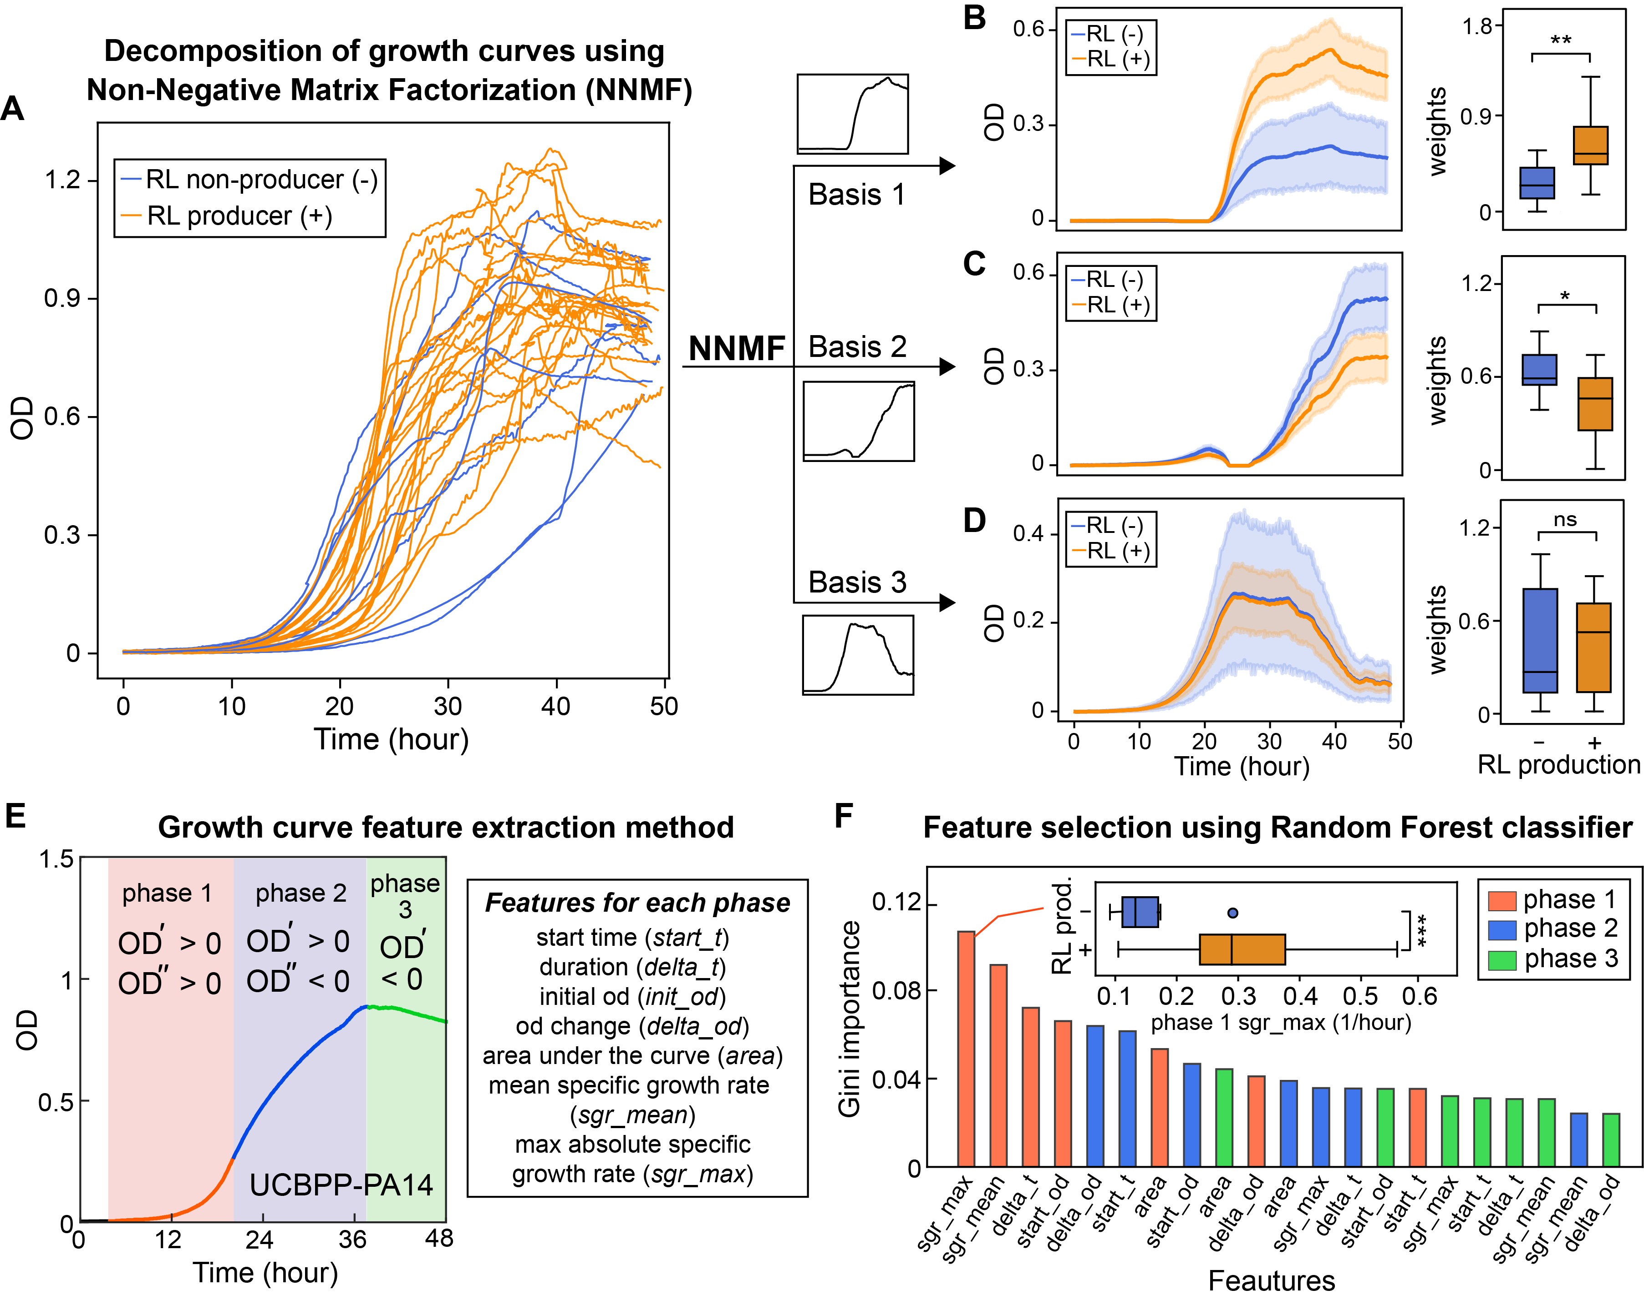
Faster growing Pseudomonas aeruginosa strains produce rhamnolipids

Slide 15
Association between protein variants with rhamnolipid production

Slide 16
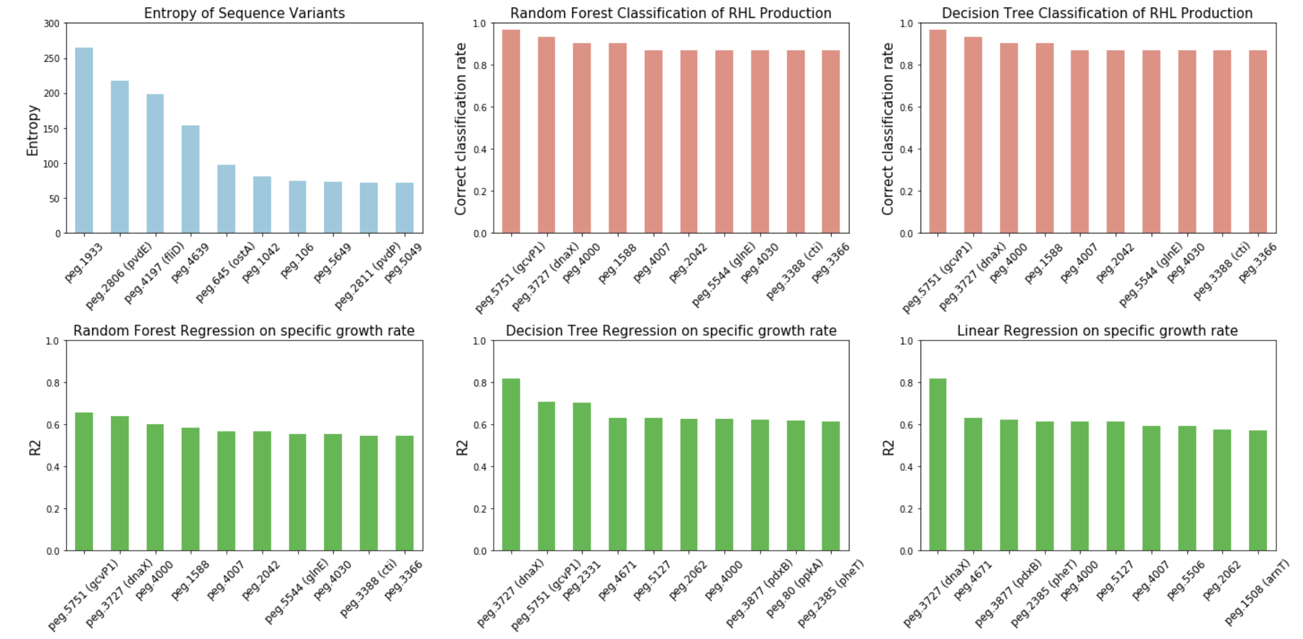
A
B
C
D
E
F
A: variance of protein amino acid sequences
B,C: classifying RHL production using protein variants
D,E,F: regression of specific growth rate on protein variants
dnaX: DNA polymerase III subunit tau
pvdE: Pyoverdine biosynthesis protein
gcvP1: Glycine dehydrogenase
fliD: Flagellar hook-associated protein

Slide 17
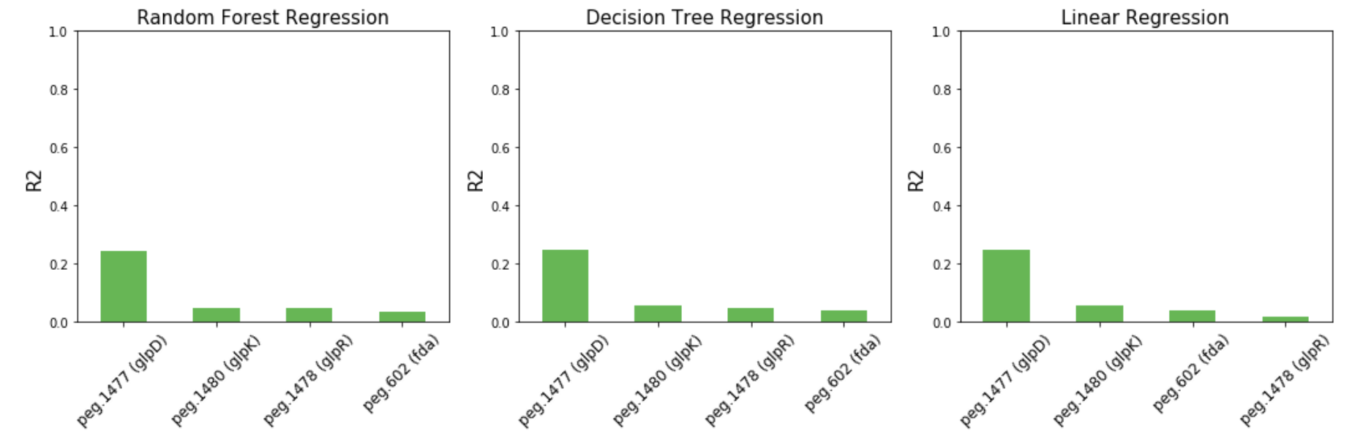
Variants in glycerol uptake proteins do not explain growth rate

Slide 18
Rhamnolipid is produced when nitrogen is limited and NADH is suboptimal

Slide 19
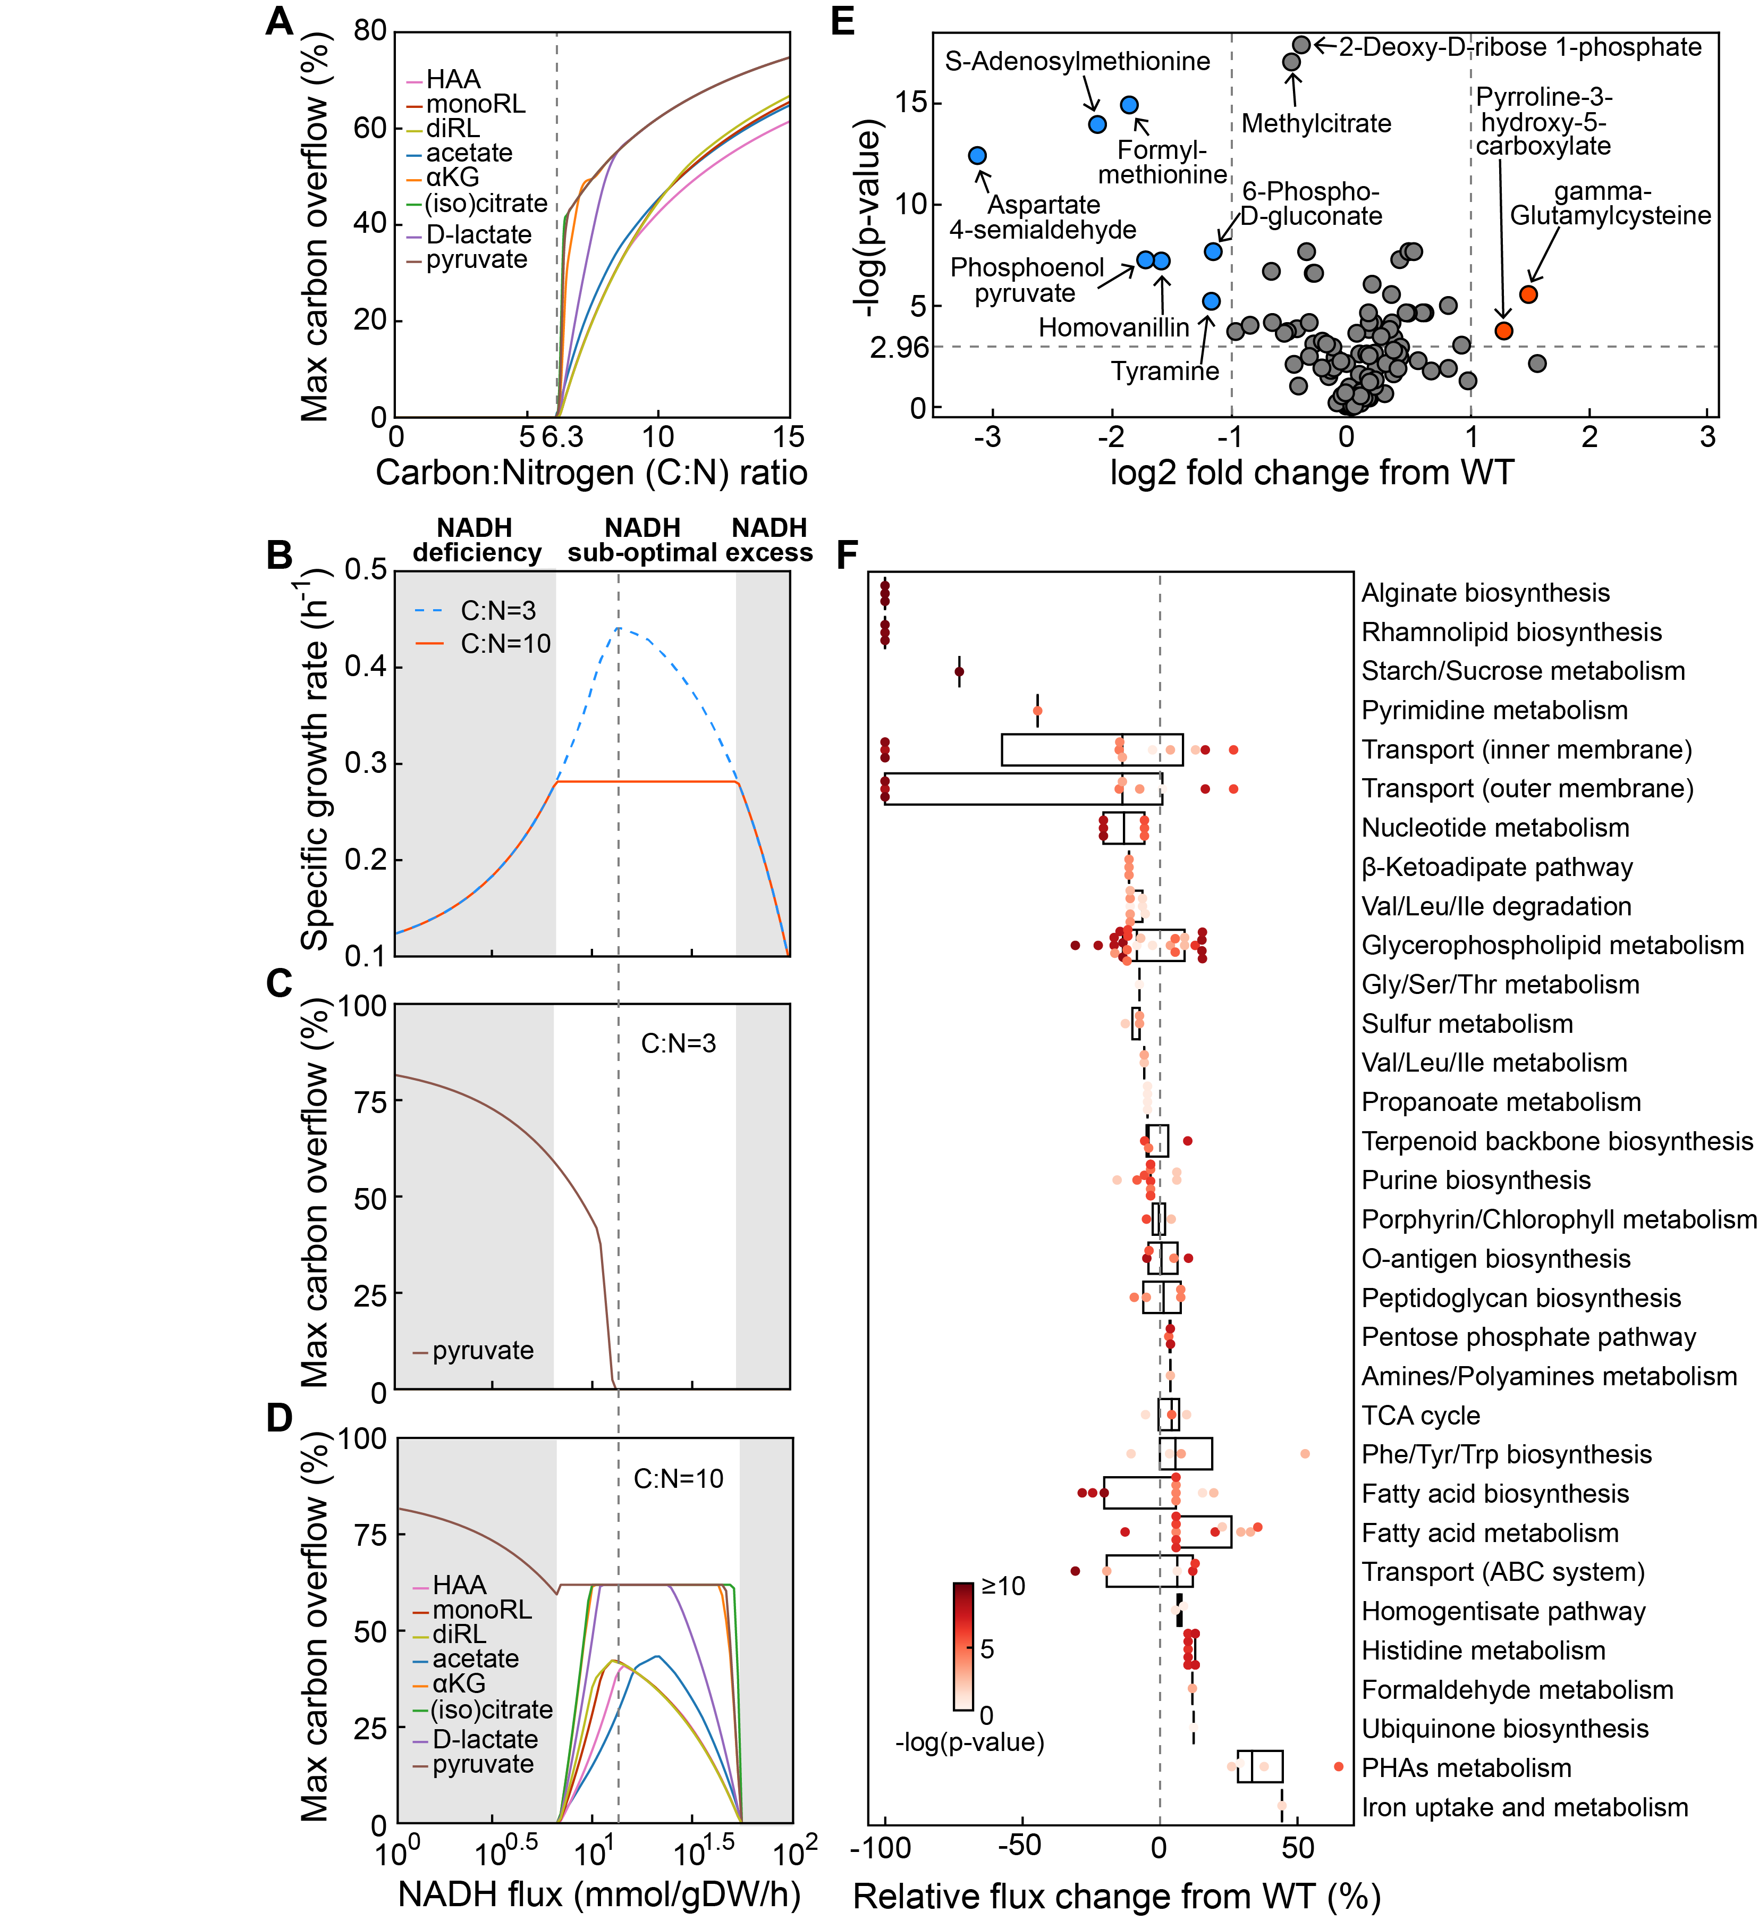
1. RL is produced when nitrogen is limited and internal NADH is suboptimal
2. Alternative pathways exist to dump excess carbon
3. [Should we expect consequence of rhlA?] No compromise in growth but metabolism is altered.
4. RhlA seems to have slight but observable increase of oxidative burden (evidenced by limited methionine and increased gamma-glutamylcysteine, both contain Sulfer)
5. Model predicts altered sulfer metabolism
6. Correlation between RHL and virulence?

Slide 20
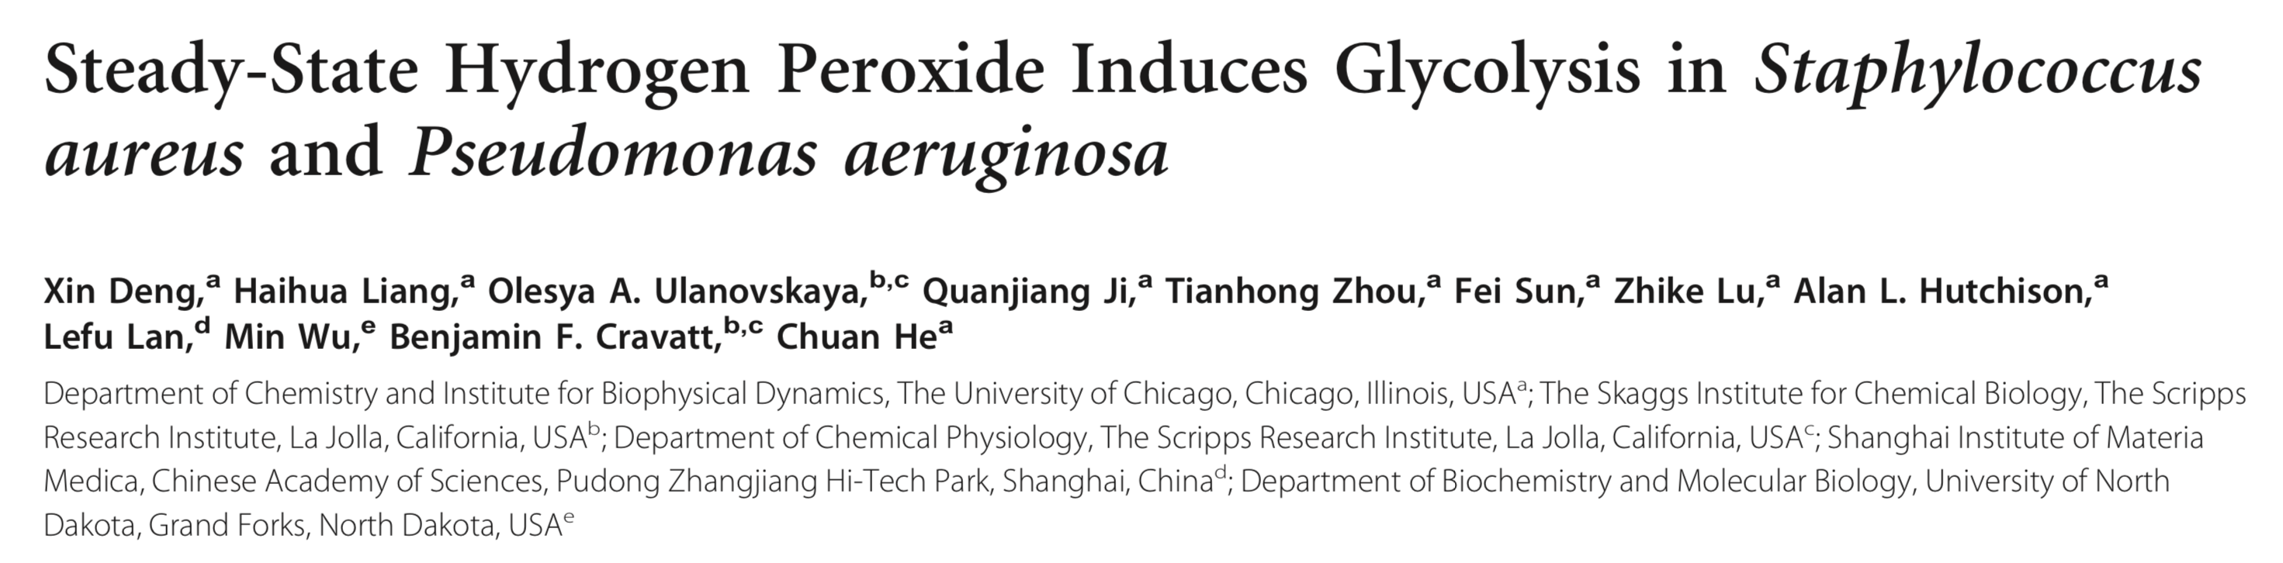
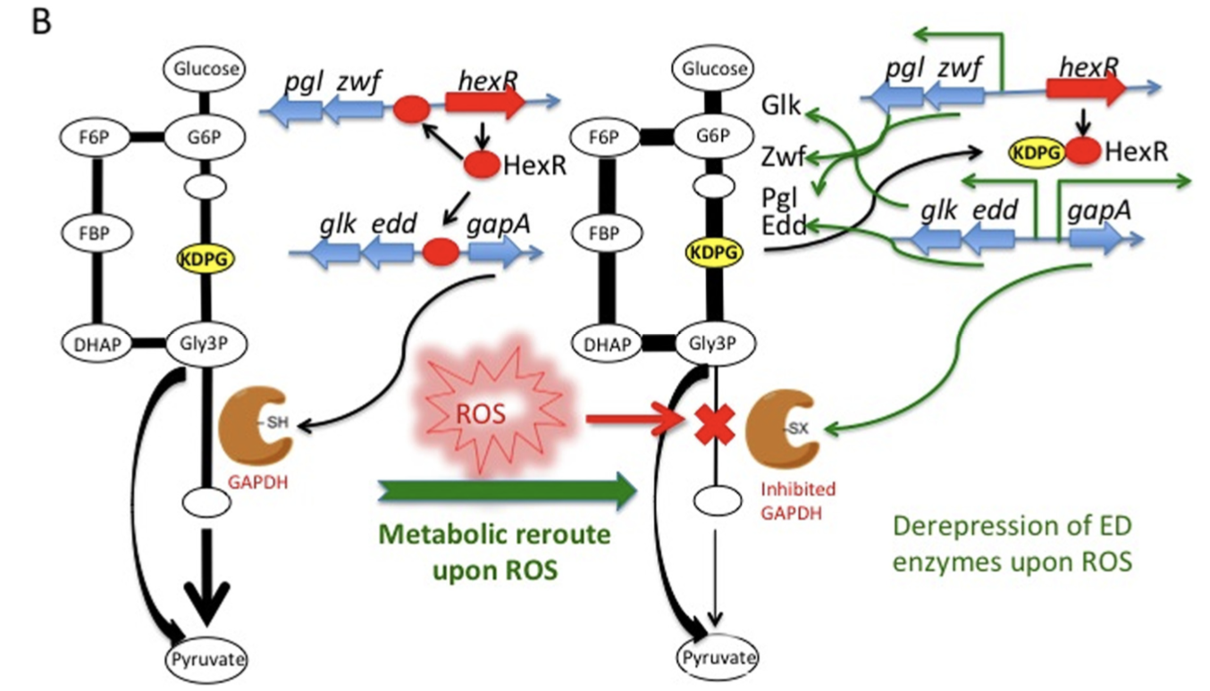

Slide 21
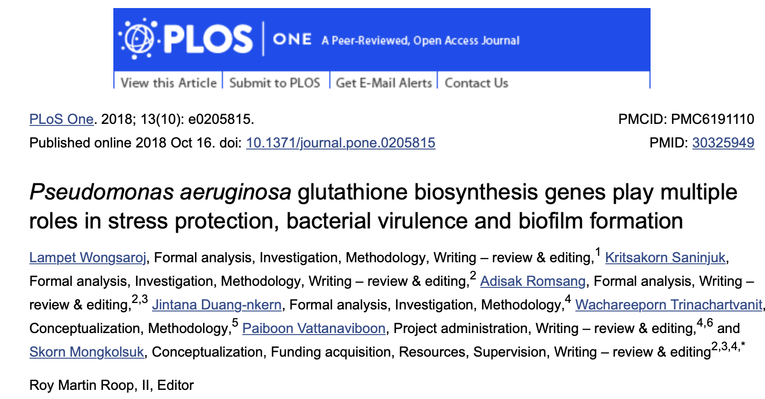

Slide 23
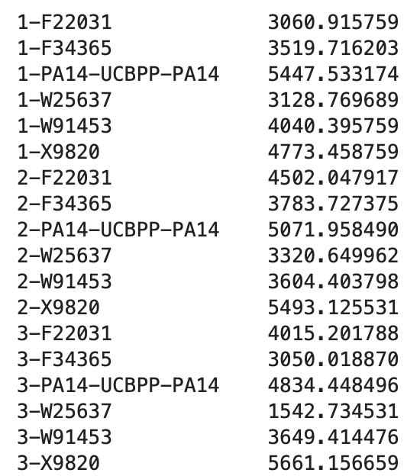
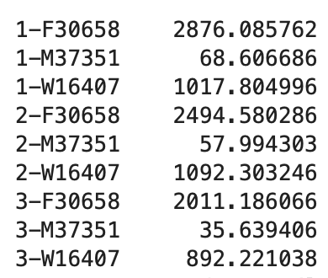
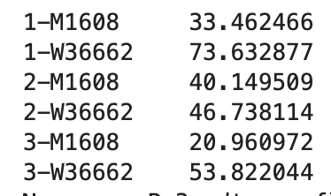
Low acp3 (Acyl Carrier Protein 3) in RL-
RL++
RL+
RL-

Slide 24
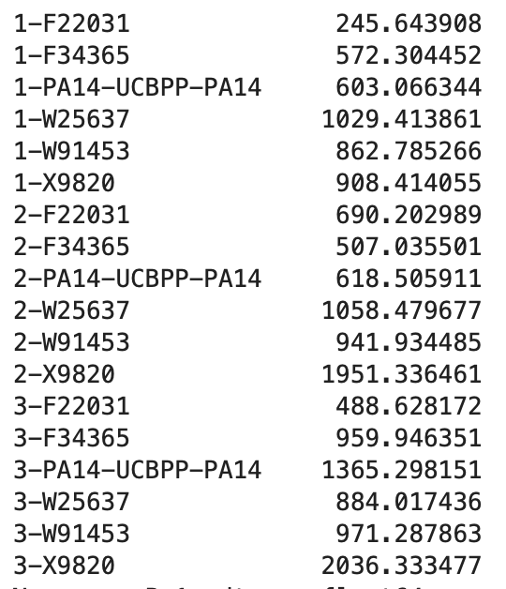
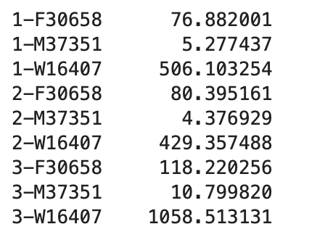
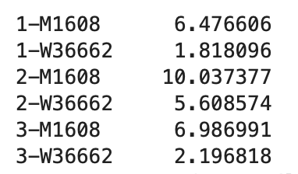
Low acp1 (Acyl Carrier Protein 3) in RL-
RL++
RL+
RL-

Slide 25
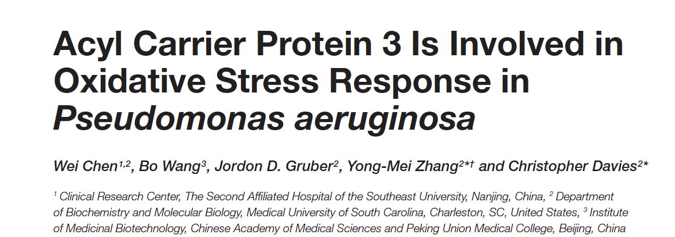
The human opportunistic pathogen Pseudomonas aeruginosa expresses three acyl carrier proteins (ACPs): AcpP, Acp1, and Acp3. The function of AcpP in membrane fatty acid synthesis (FAS) was confirmed recently, but the physiological roles of Acp1 and Acp3 remain unclear. To address this, we investigated the physiological role of Acp3 in P. aeruginosa . We found that expression of Acp3 dramatically increases in the log phase of cell growth and that its transcription is under the control of the QS regulators LasR and RhlR. Deletion of acp3 from P. aeruginosa strain PAO1 results in thicker biofilm formation, increased resistance of the strain to hydrogen peroxide, and higher persistence in a mouse infection model. Tandem affinity purification (TAP) experiments revealed several novel protein-binding partners of Acp3, including KatA, the major catalase in P. aeruginosa. Acp3 was found to repress the catalase activity of KatA and, consistent with inhibition by Acp3, less reactive oxygen species are present in the acp3 deletion strain. Overall, our study reveals that Acp3 has a distinct function from that of the canonical AcpP and may be involved in the oxidative stress response.
Low acp3 reduces oxidative stress
Acp3 under control of LasR and RhlR
No difference in katA between RL++/RL+ and RL-

Slide 26
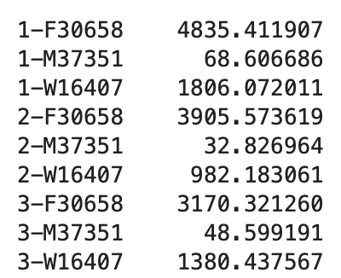
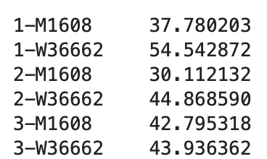
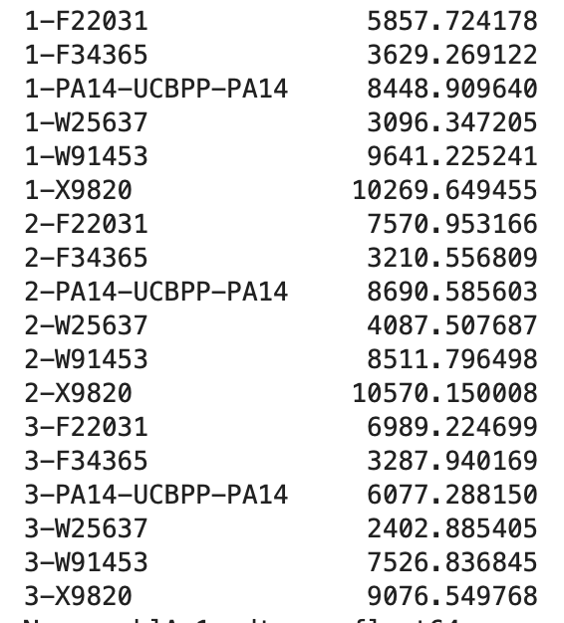
RhlA (not RhlB) is down regulated in RL-
RL++
RL+
RL-
RhlR is not found in RNAseq

Slide 27
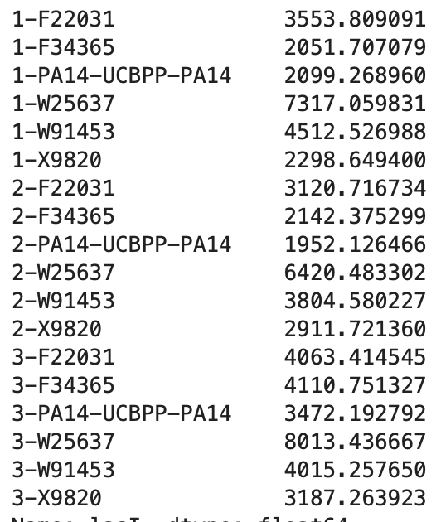
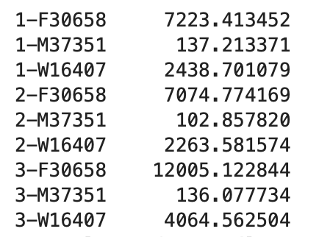
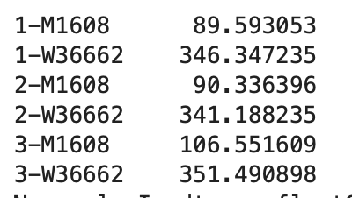
lasI is down regulated in RL-
RL++
RL+
RL-
No difference in lasR

Slide 28
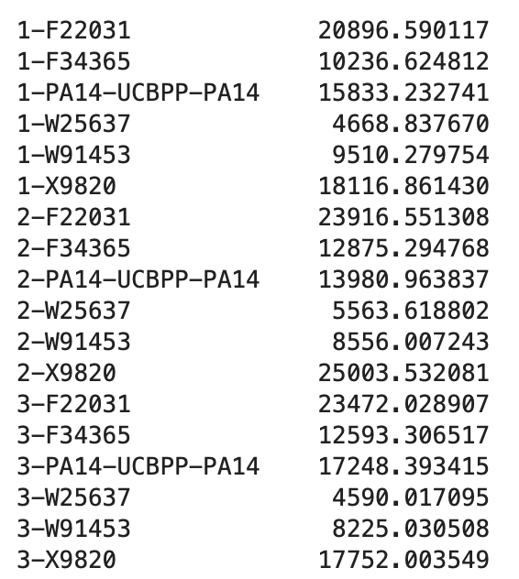
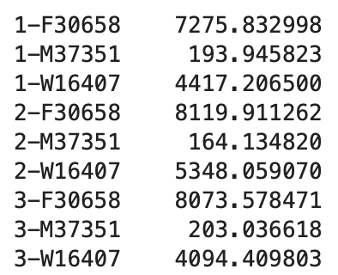
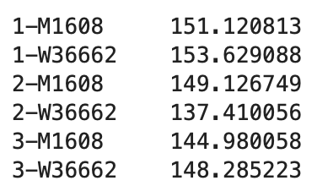
lasB is down regulated in RL-
RL++
RL+
RL-

Slide 29
QS system is compromised in RL-

Slide 30
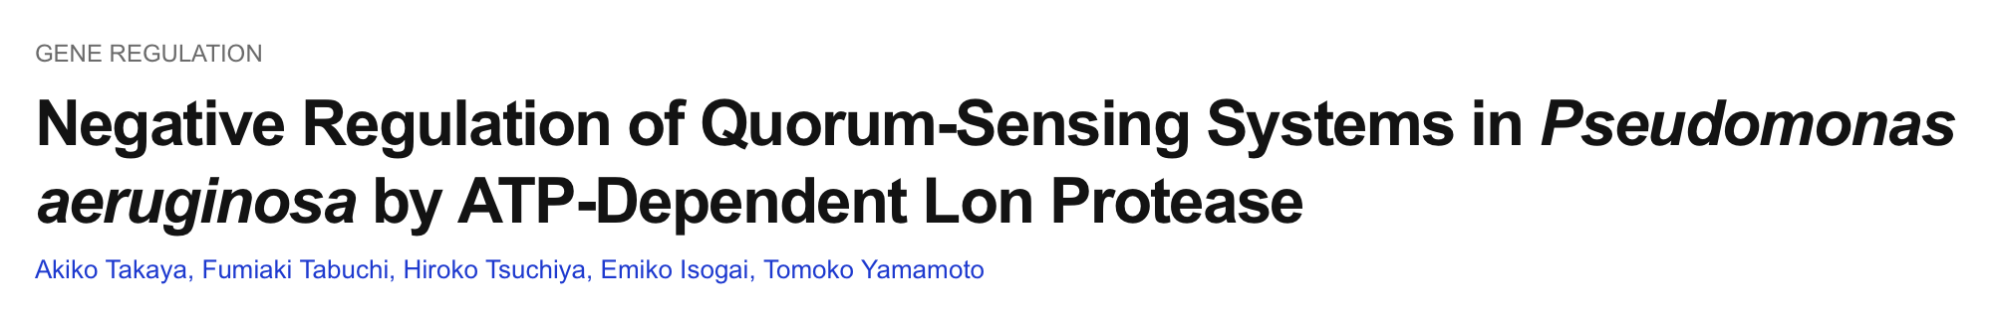
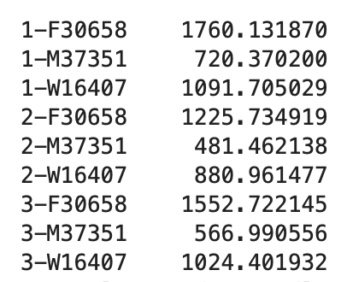
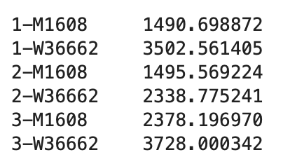
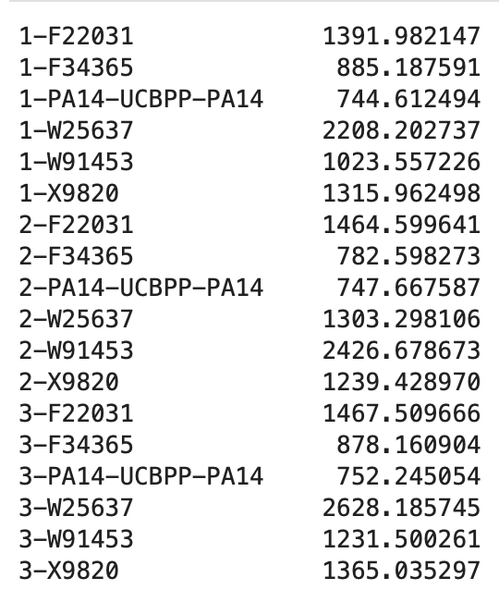
Lon protease
QS
Lon2
RL++
RL+
RL-
No difference in lon 1 (lon 3 expression is too low)

Slide 31
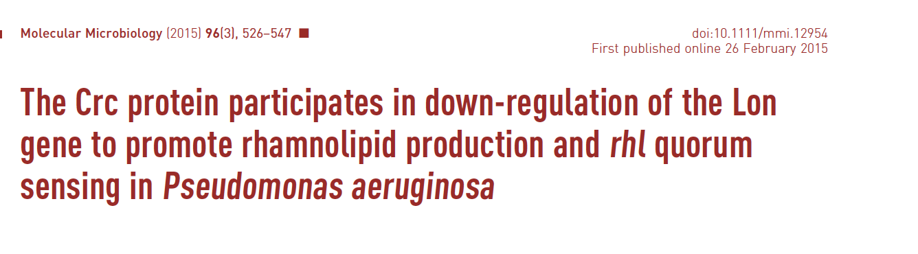
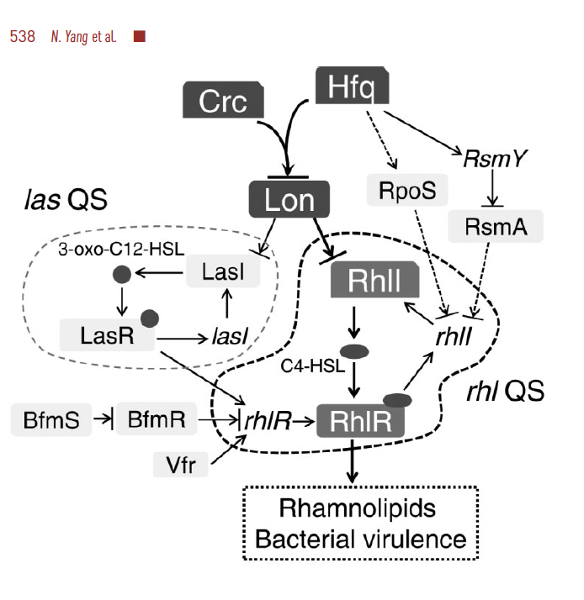

Slide 32
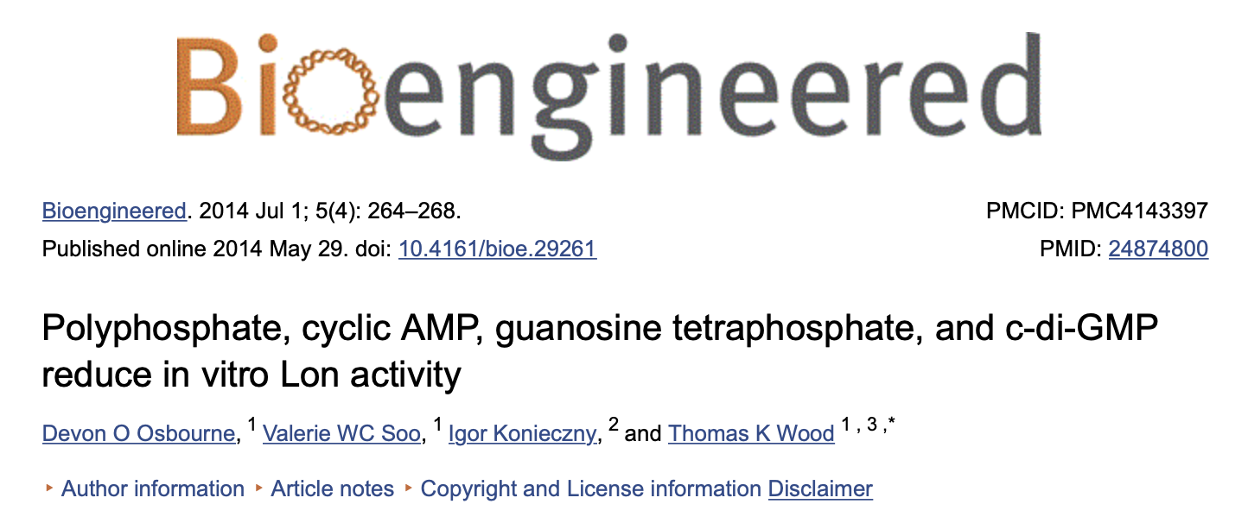

Slide 33
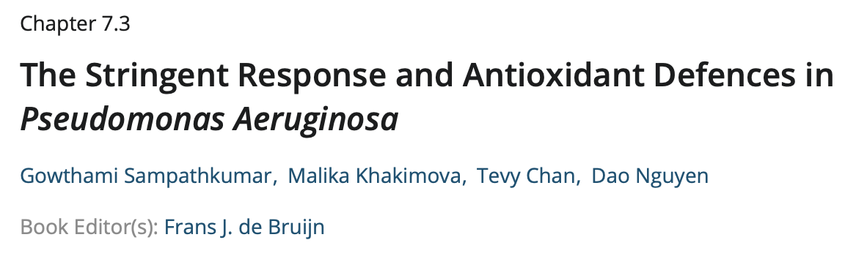
Pseudomonas aeruginosa , an important model environmental organism and opportunistic pathogen, possesses antioxidant defenses to survive oxidative stress. Enzymatic scavengers are major defenses against the dominant reactive oxygen species, including hydrogen peroxide and superoxide anion. The stringent response, mediated by the alarmone (p)ppGpp, is induced by nutrient and other stress signals. Our studies examined the role of the stringent response in P. aeruginosa and show that expression of the catalases katA and katB , alkyl hydroperoxide reductase ahpCF , and superoxide dismutases sodA and sodB are under the control of the stringent response.

Slide 34
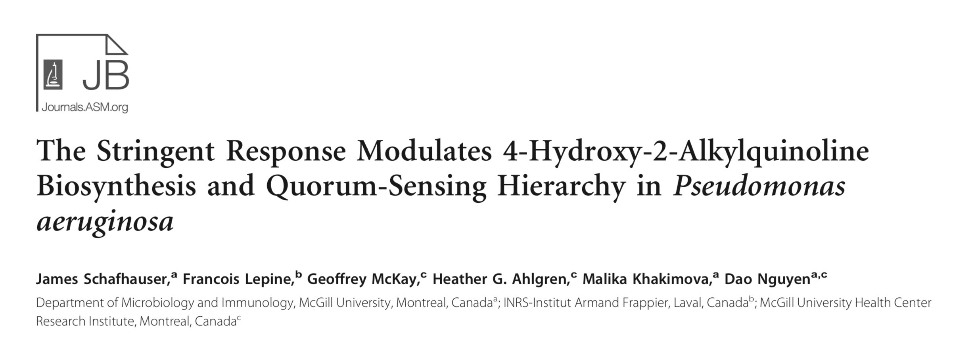
As a ubiquitous environmental organism and an important human pathogen, Pseudomonas aeruginosa readily adapts and responds to a wide range of conditions and habitats. The intricate regulatory networks that link quorum sensing and other global regulators allow P. aeruginosa to coordinate its gene expression and cell signaling in response to different growth conditions and stressors. Upon nutrient transitions and starvation, as well as other environmental stresses, the stringent response is activated, mediated by the signal (p)ppGpp. P. aeruginosa produces a family of molecules called HAQ (4-hydroxy-2-alkylquino- lines), some of which exhibit antibacterial and quorum-sensing signaling functions and regulate virulence genes. In this study, we report that (p)ppGpp negatively regulates HAQ biosynthesis: in a (p)ppGpp-null (􏰀SR) mutant, HHQ (4-hydroxyl-2-hep- tylquinoline) and PQS (3,4-dihydroxy-2-heptylquinoline) levels are increased due to upregulated pqsA and pqsR expression and reduced repression by the rhl system. We also found that (p)ppGpp is required for full expression of both rhl and las AHL (acyl- homoserine lactone) quorum-sensing systems, since the 􏰀SR mutant has reduced rhlI, rhlR, lasI, and lasR expression, butanoyl- homoserine lactone (C4-HSL) and 3-oxo-dodecanoyl-homoserine lactone (3-oxo-C12-HSL) levels, and rhamnolipid and elastase production. Furthermore, (p)ppGpp significantly modulates the AHL and PQS quorum-sensing hierarchy, as the las system no longer has a dominant effect on HAQ biosynthesis when the stringent response is inactivated.

Slide 35
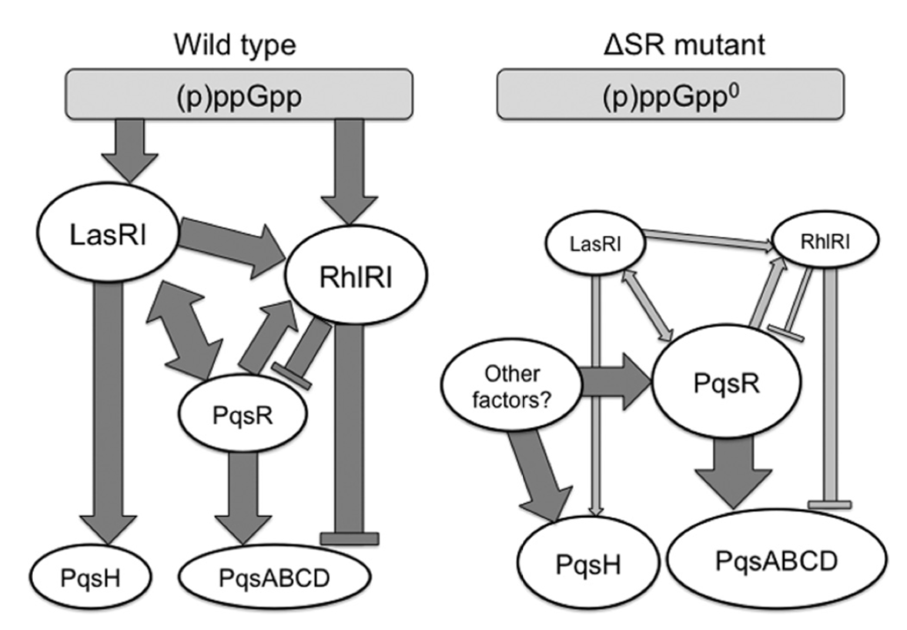

Slide 36
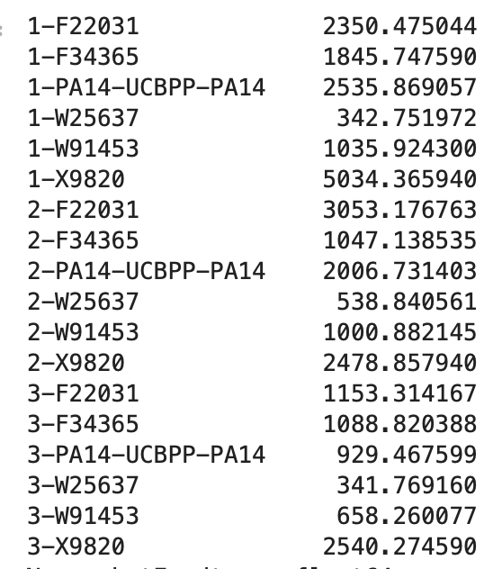


katE
RL++
RL+
RL-
katA, katB no difference

Slide 37



ahpF_2
RL++
RL+
RL-
ahpF, ahpC_1, ahpC_2, ahpC_3, sodB_1, sodB_2 no difference

